Slide 1
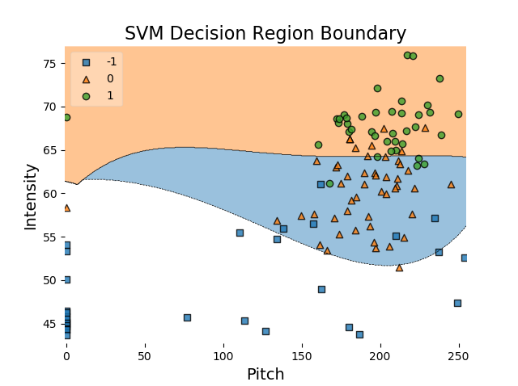

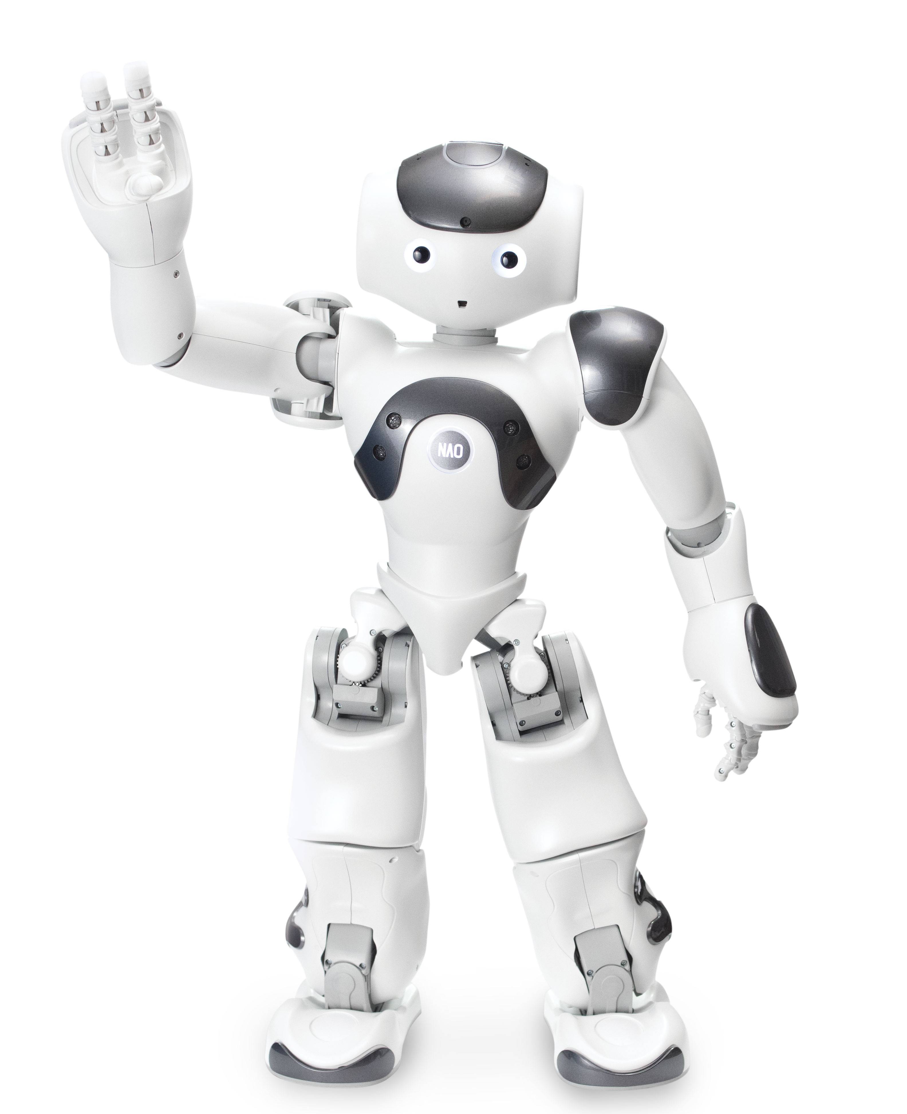
CS 043
Background
Building More Self-Aware Everyday Robots
Team MEmbers
As human-robot interactions become increasingly commonplace it is important to make the experience feel natural. By studying the ability of a robotic comedian to perceive social cues from an audience and adjust its behavior appropriately insight can be gained into how interpersonal communications between robots and humans can be improved. Our project will study the ability of a robot to determine how well a joke is received based on the laughter it hears and seek ways to improve the success rate of its analysis.
Timothy Bui
Yuhang (Tony) Chen
Brian Ozarowicz
Trevor Webster
[Insert thing here (Something something robot comedy)]
Problem
About Our Team
Interactions with robots have become increasingly commonplace in modern society as new technologies and uses for robots emerge in fields ranging from industry to rehabilitation to everyday personal assistants. One of the major problems present in human-robot interactions is a robot’s ability to understand and adapt to human reactions, both verbal and nonverbal, to changes in a situation. This is a complex problem that includes a large number of different types of research such as human recognition, natural language processing, predictive analysis, and task planning. Currently, many human-robot interactions feel unnatural or ineffective as users are required to give clear, specific commands to robots in order to get them to perform as intended. In many situations, robots are not sophisticated enough to react naturally in real environments as they encounter events that are outside the scope of their programming.
We are a team of four computer science from many different backgrounds and concentrations. Using our diverse knowledge, we set out to improve an existing automated machine learning system to detect human reception to a joke told by a robot.
Our team operated in two parts: one researching and working on the post-joke laughter/reception detection and the other working on the same for the mid-joke laughter detection.
Acknowledgements
Dr. Naomi Fitter
John Vilk
Ella Bisbee
Post-Joke Classification by Feature (Pictured Above)
Mid-Joke Classification
Features are Pitch, PitchSd, Intensity, IntensitySd, MaxSound, MinSound
SVM (support vector machine) Classifier to separate data
2 Class or 3 Class (pictures) classification
95% and 85% accuracy respectively
Bullet. lum exer adipsustrud doloree tuerat lorpera esenibh eu faccum eum iuscili quamcommy nit lorerillut ullam quat lore verostrud ming faciliquisse modolortin volore
Vel et vel dionsenit adit, consenim zzrillute el euguerostie faci bla conse ad essi. Vel et vel dionsenit adit, consenim zzrillute el euguerostie faci bla conse dolore tet, volobor si.
Lore del utatis amcorpercin henim riliq uismodo leniat aciduisl il eugait velis nos alit prat ad tions et vel euguerostie dolore tet, volobor si.
Sim ipsum dolorem velis aut vulputpat eu facilit am delestrud eui blan vendre elisisc illaorp ercilisi blan eu amconsequat, senisi.

